Slide 1
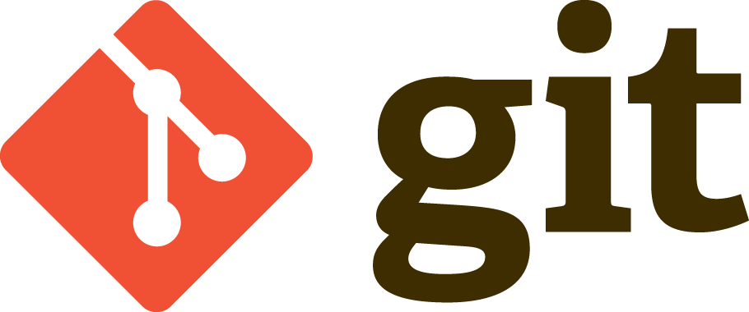




Using Git and github to Enable Open Ocean Science
James Munroe @jmunroe
9.24.XX
Notes:
Welcome. In this talk I will introduce git as a version control system and explain its role in enabling open science.

Slide 2
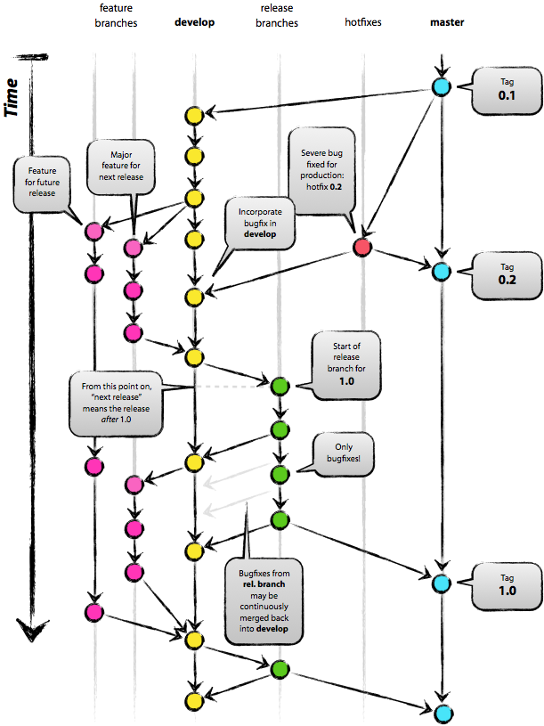
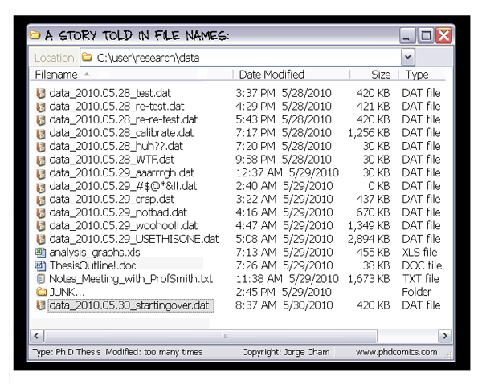
What is Version Control?
A way to backup changing files
Keep a history of old versions with annotations
Manage merging of changes between different versions/streams of the files/documents.
Notes:
Version control has been developed since the 1970s as a fundamental technology in software development. It is applicable to any body of knowledge that is built up incrementally and involves multiple collaborators. While originally for software, it naturally extends to data and science publications as well.
Version control backs up changing files, keeps a history of those changes with detailed log messages, and facilitates merging those from multiple authors.
If you have directories that look like this screen shot, then perhaps you should be considering a version control system

Slide 3
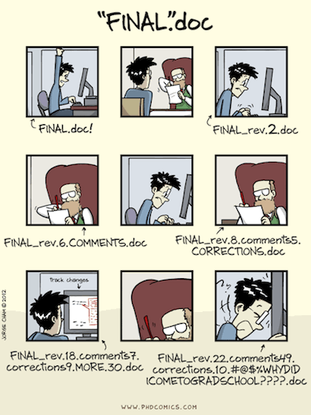
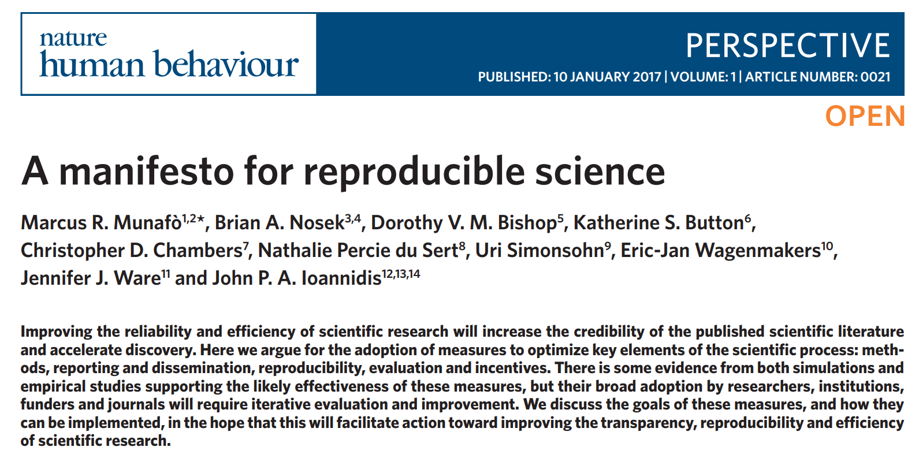
Why use Version Control?
Open science: transparency and reproducibility
Enables collaboration
Time machine for your projects
Open scientific work is more useful and more highly cited than closed.
Notes:
In open science, transparency and reproducibility are important values which are by products of using a version control system.
It enables collaboration between colleagues. Importantly, it also allows collaboration between yourself when using multiple computers.
Working as time machine for your projects, it gives you the power to track blame and/or praise and removes the fear of breaking things
In publications about open and reproducible science, reference is often made to the important of version control for sharing code, data, and publications.

Slide 4
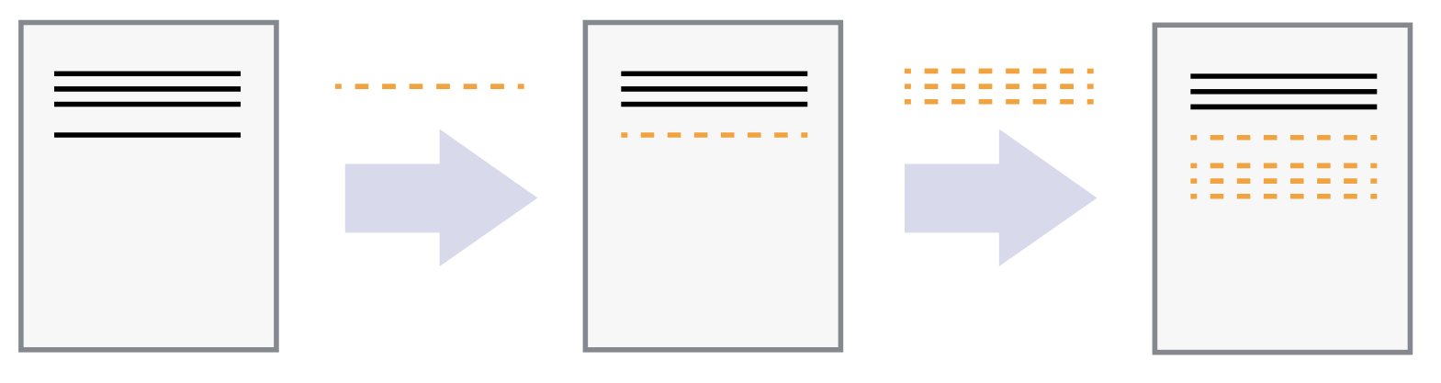
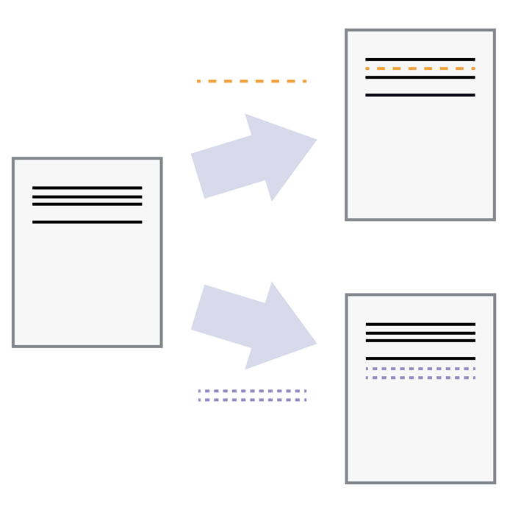
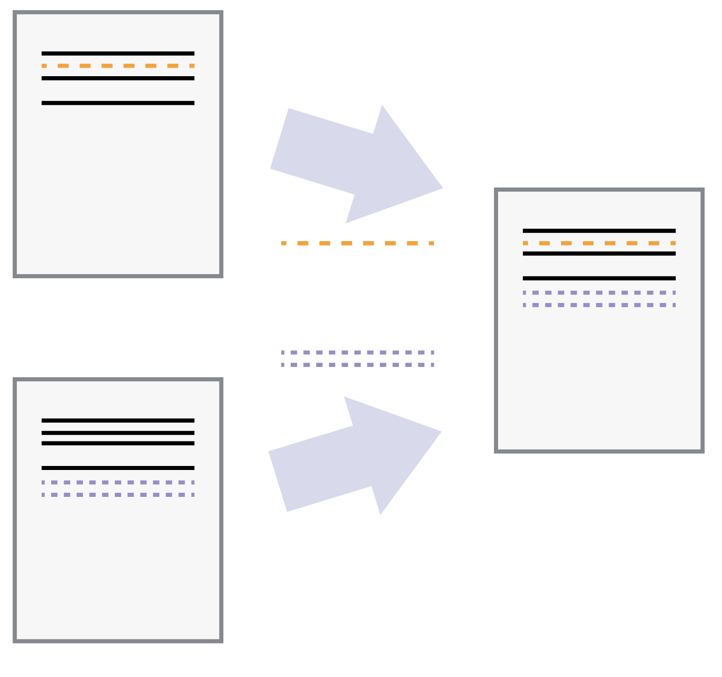
How Do VERSION CONTROL systems (VCS) WORK?
Starting from a base document, each commit is a discrete set of changes.
VCS allow multiple authors to concurrent work on a document
VCS can resolve and merge changes on the same document.
Notes:
We can compare version control to “Google Drive or Dropbox” where there are shared files or a “Track Changes” feature in an application like Microsoft Word.
Traditional version control systems start with a base document and then record the changes made in discrete steps. Think of it as a tape: if you rewind the tape and start at the base document, then you can play back each change and end up with your latest version.
If the changes are separate from the document itself, you can then think about “playing back” different sets of changes onto the base document and getting different versions of the document.
The older version is just playing back one change, the new version is playing back the number two change.
This allows two authors can make independent sets of changes based on the same document. A common example might be you edit a file on your laptop and then also on your Which copy is the “new one”? They both are.
Yet, version control solves the problem of handling merging those changing back together.

Slide 5
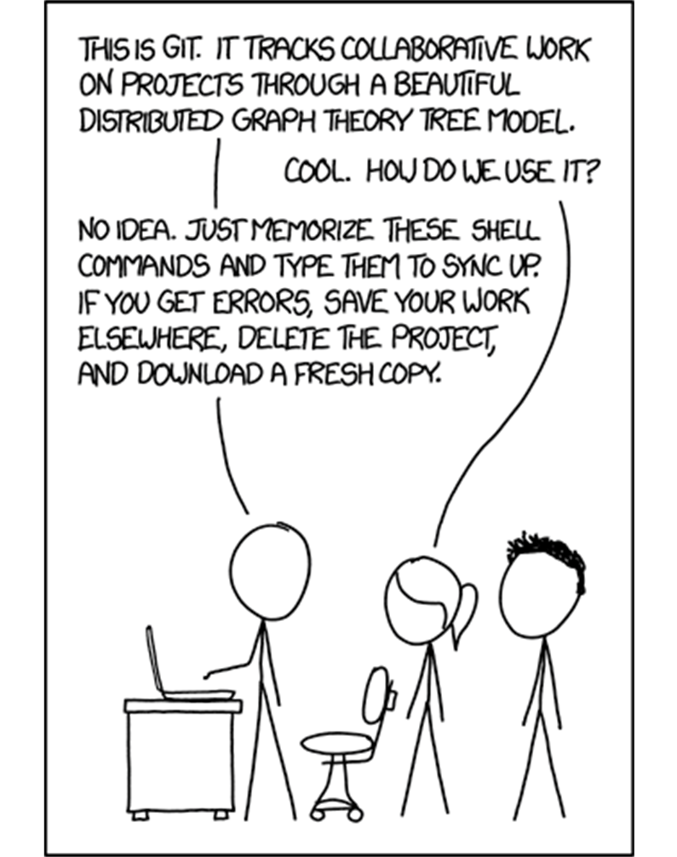
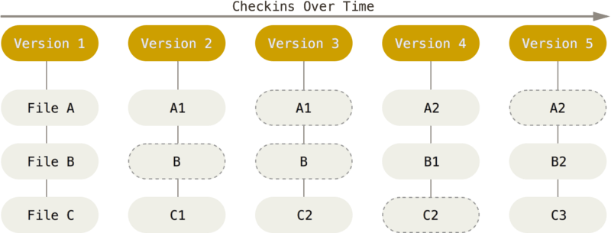
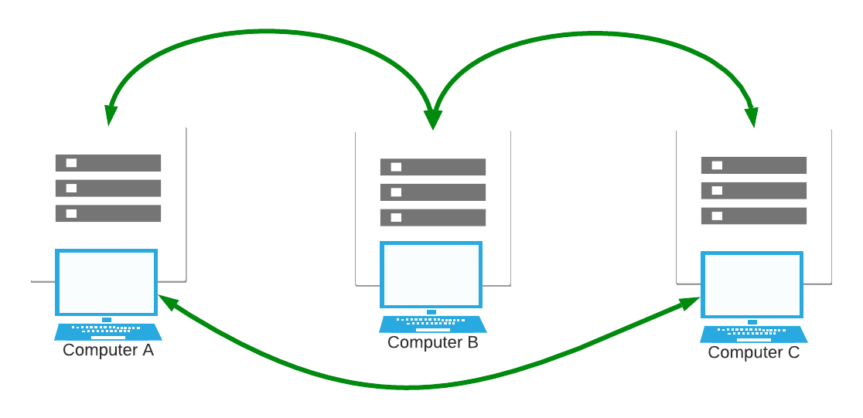
How does Git Work?
Git tracks snapshots of sets of files
Git is a distributed version control system (VCS)
“xkcd” by Randall Munroe, https://xkcd.com/1597/
Notes:
There are other version control systems available, but at the moment, git is incredibly popular especially in open science.
Unlike many traditional version control system, git tracks snapshots of a whole file system. It is not just a new version of each file that is being tracked, but the entire collection of files all together.
In git, each snapshot is called a commit.
Services like GitHub make it easier to organize relationships between repositories, but a central server is not required with git.
Git is a “distributed” version control system, where there is no special copy of the data. Every computer’s repository has a complete copy of the history of all the data.
Its technical design makes it very fast even for very large projects with thousands of different contributors.
However, as suggested by this XKCD comic, git sometimes has a reputation of being a cryptic and mysterious. My hope is this presentation provides some insight.

Slide 6
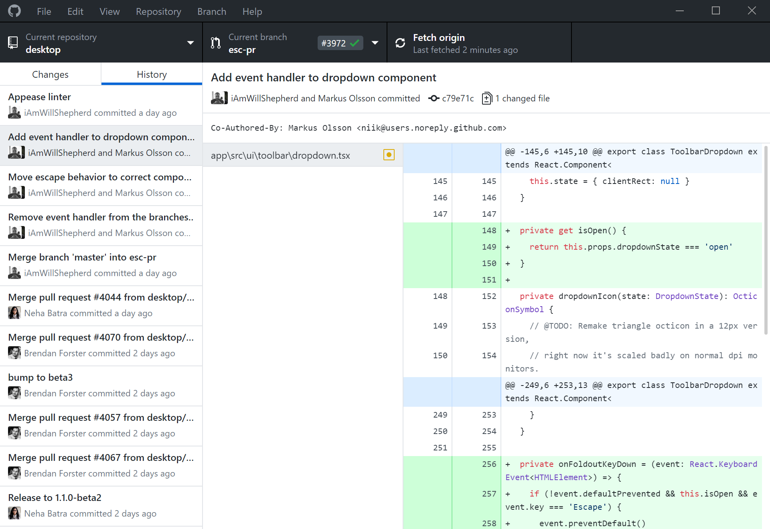
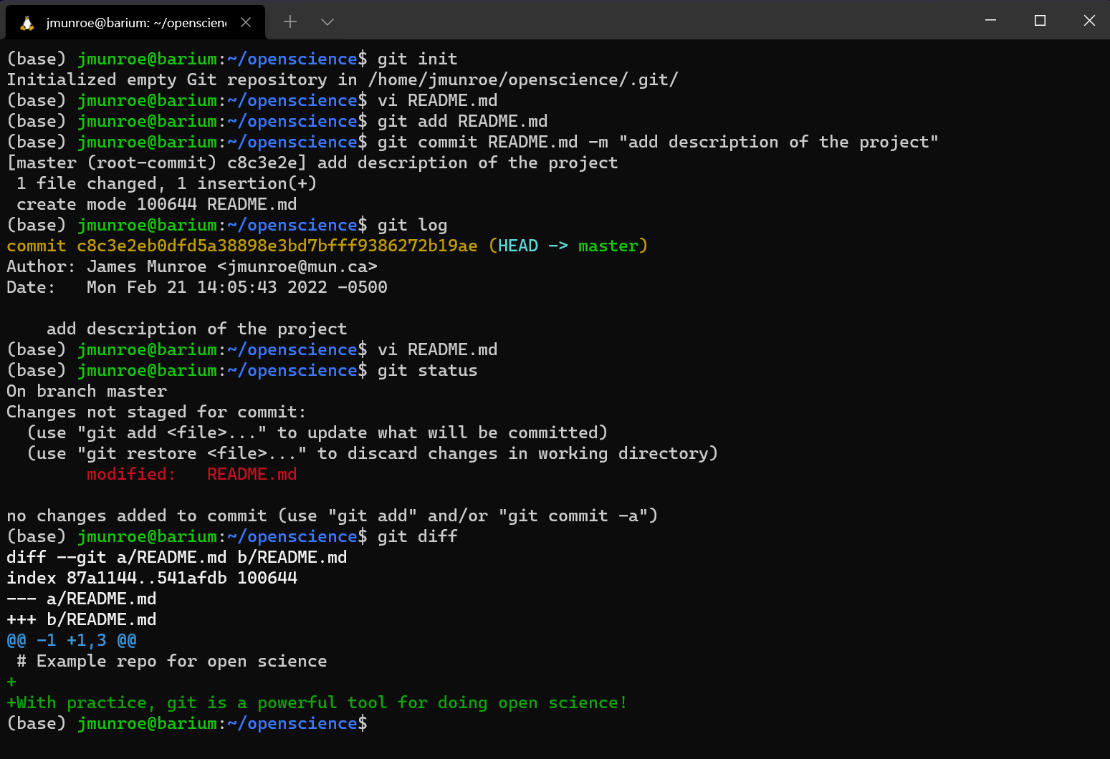
Tools
Command line git
GitHub Desktop
Notes:
Front end tools for working with git include the command line or desktop applications such as GitHub Desktop.
A quick note on “GitHub” and how that is different from Git. GitHub supports much more than just version control. It also includes development tools such as issue tracking, project management and collaboration tools, and continuous integration/development features.
Learning what the commands actual do by using a lower level tool like command line git is great for understanding. For productivity, using tools built into your favourite applications may be better.
For example, I do much of my day-to-day work in the editor Visual Studio Code. There are plugins and extensions that allow me to add and commit changes with git from within that editor.
While not a perfect analogy, recall learning elementary school math – we learned how do so things by hand to understand but often use calculators in practice. There is value in learning git with the command line.

Slide 7
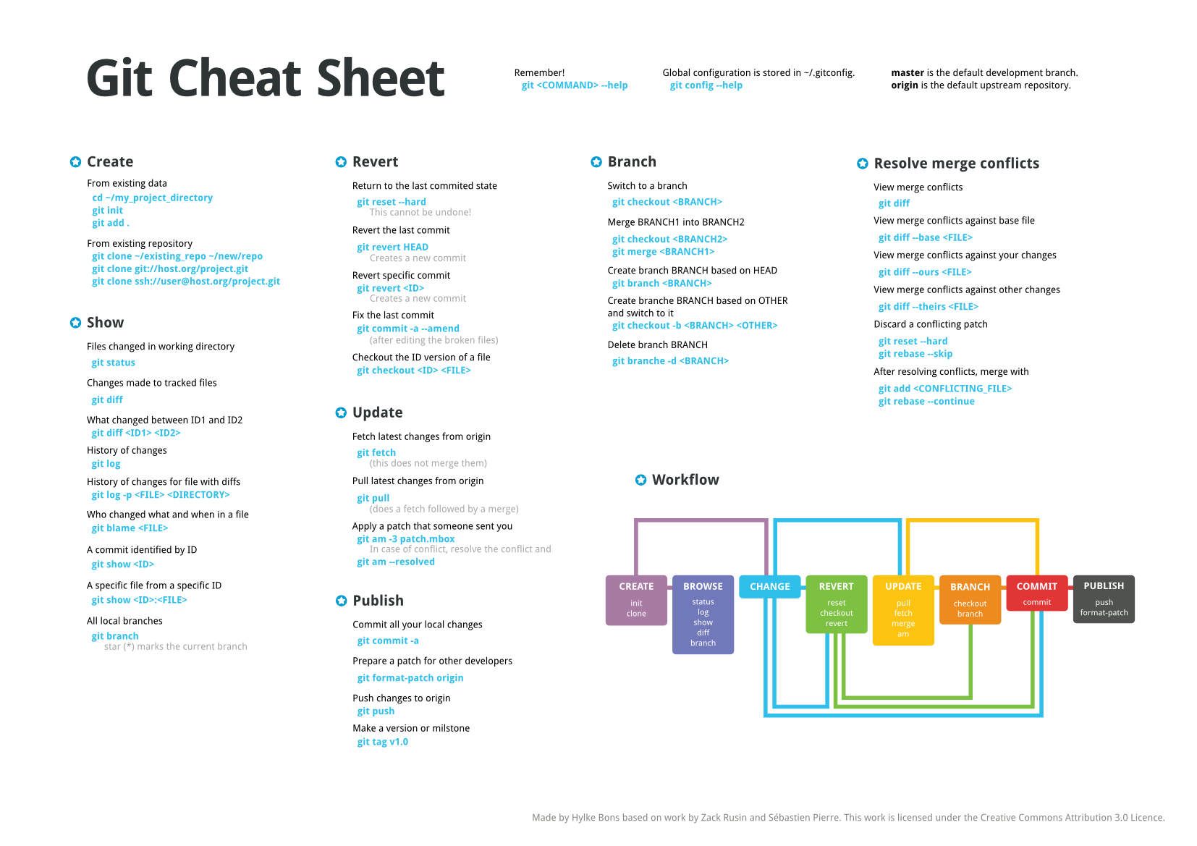
Adapted from work by Hylke Bons based on work by Z. Rusin and S. Pierre. CC 3.0 License.
Notes:
Here is the overall git workflow. These are the command line versions of the steps, but any graphical client will be doing these same tasks.
We start by getting a copy of the repository. Assuming we are continuing an existing project, this is called “cloning”. Git is a distributed version control system, so cloning mean making a local copy of both the current version of all files AND the complete history of all the commits, that is all historical version of the files.
Git has commands like status and log that are able review the repository of the project seeing the changes that were made, who made them, and when.

Slide 8
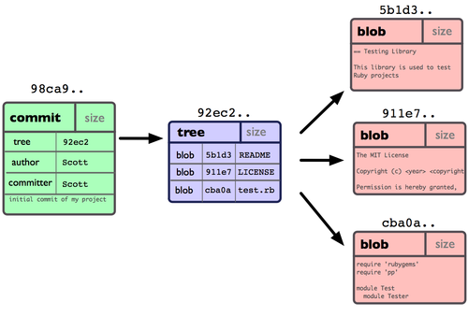
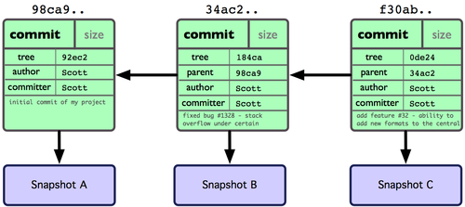
Image Credit: ProGit book, by Scott Chacon, CC License.
commit
repository
A snapshot of work at a point in time
A group of linked commits
Note: these form a Directed Acyclic Graph (DAG), with nodes identified by their hash.
hash
a fingerprint of the content of each commit and its parent
ICESAT-2HackWeek/intro-jupyter-git: Introductory tutorials to the Jupyter ecosystem and Git (github.com)
Notes:
One you’ve made some changes, you “commit” those change to the repository. Each commit is reference with a hash or code that uniquely identifies it and what commit it is based off. While not exactly equivalent, a git commit history shares similar elements to a “blockchain” that you may have heard about related to cryptocurrencies and NFTs.
A commit in git represents a file system tree with number files (sometime called blobs or objects). Commits are linked together to form a repository. It is this repository that is replicated when cloned.
References to these hashes are how git distinguishes different version of files. The “HEAD” id is an alias for the most recent commit hash. A branch is just a reference to another commit that is not the head. As such, branches are incredibly cheap to make in the git framework.
Commits also require the used of log messages. Log messages are very useful if used properly. They help other people (your colleagues, your future self), a to understand the intentions of this commit. A good commit message captures the intention of a commit and provides some context.

Slide 9
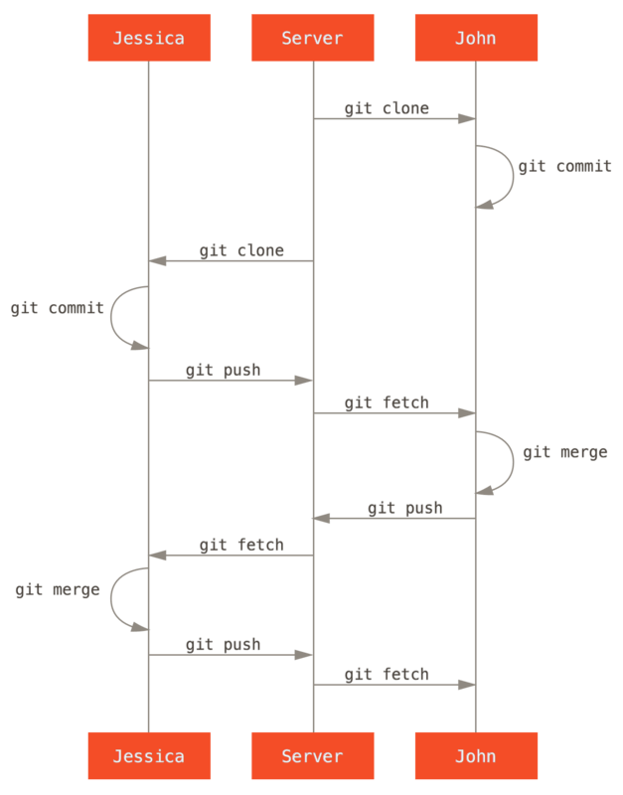
Pushing and pulling
Distributed Version Control
A pull is fetch followed by a merge
A central server is not strictly required at all for git
Many projects use a centralized service to facilitate communication and collaboration.
Credit: ProGit book, by Scott Chacon, CC License.
Notes:
Finally, you can fetch changes from someone’s else repository and merge those changes into our repository. Together a fetch and a merge is called a pull. To share changes from your repository to someone else you can push those changes.
There is really nothing special from git’s point of view about the “server”. Git doesn’t need a central repository since a fully distributed system.
However, to communicate that new changes have been made services like GitHub are often used as part of the git ecosystem. This communication has led to the growth of online communities such as the Pangeo project.
And being able to participate it those communities where open ocean science is being done is a strong incentive to take the time to learn how to use git.

Slide 10
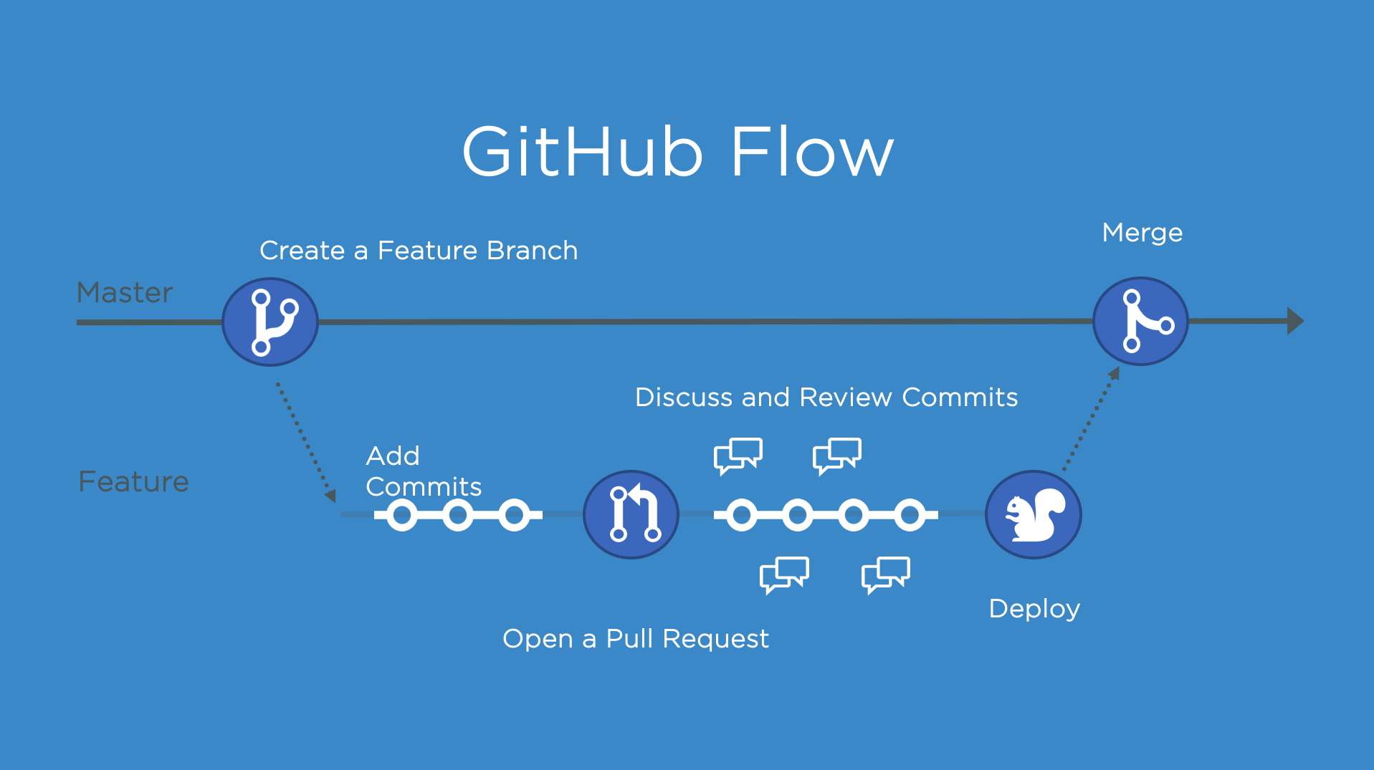
Fork
A fork is a copy of a repository that you manage. Forks let you make changes to a project without affecting the original repository.
Pull Request (PR)
Pull requests let you tell others about changes you've pushed to a branch in a repository on GitHub.
Notes:
When using GitHub we also need to introduce two new concepts: forking and pull requests.
A fork is a copy of a repository that you manage. Forks let you make changes to a project without affecting the original repository. You can fetch updates from or submit changes to the original repository with pull requests.
Pull requests let you tell others about changes you've pushed to a branch in a repository on GitHub. Once a pull request is opened, you can discuss and review the potential changes with collaborators and add follow-up commits before your changes are merged into the base branch.
GitHub supports pushing direction to a repository as well, but with pull requests you can allow anyone to contribute to a project without them first having to be a trusted party. A PR is just that… it is a request that a repository maintainer will make a git pull from a forked repository.

Slide 11
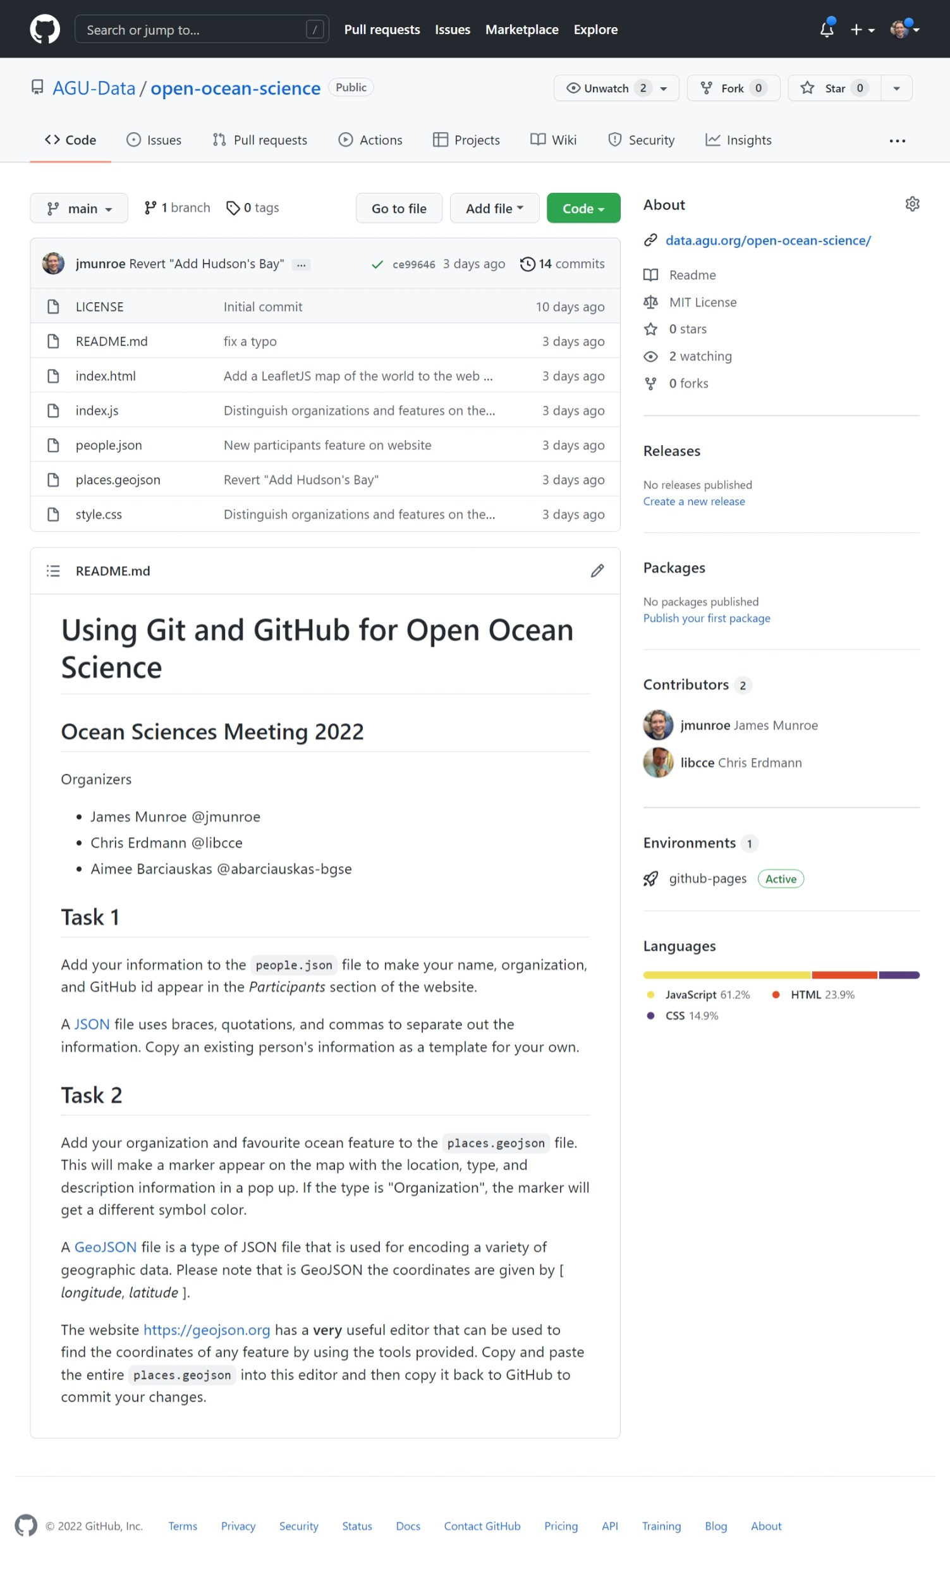
Tutorial
Create a GitHub account
Contribute to a website by adding data to a repository: AGU-Data/open-ocean-science (github.com)
Experience making a commit and getting a pull request accepted on a collaborative, open project.
Notes:
As a way to experience using git and GitHub, we’ve design a short tutorial for the second part of this session. I am looking forward to you joining us. Thank you.

